Slide 1

Lab session 1, Tutorial 1
TA: Mohammed Shehab
Dr. Bahareh Goodarzi
COEN 352: Data structure and algorithm

Slide 2
COEN 352 Data Structure and algorithms
Section code : GD
Time: Monday, 10:15 AM – 11:15 AM
TA: Mohammed Shehab
Email: m_shehab@live.concordia.ca

Slide 3
Outlines
Introduction to Java.
Installing Java Development Kit.
Java programming language.

Slide 4
Intro to Java Programming
History of JAVA: In 1990, Sun Microsystems Inc. (US) has conceived a project to develop software for consumer electronic devices that could be controlled by a remote.
This project was called Stealth Project, but later its name was changed to Green Project.
Project heads thought C and C++ could be used to develop the project.
But the problem they faced is that the systems could use various processors that the electronics devices might use.
They start to develop a new language that was system independent.

Slide 5
Write Once, Run Anywhere
JVM is an engine that provides a runtime environment to drive the Java Code or applications.
It converts Java bytecode into machine language.
JVM is a part of Java Run Environment (JRE).
To install JVM, you need to install JRE that is the full form of JVM is Java Virtual Machine.
https://bit.ly/2RiZT3H

Slide 6
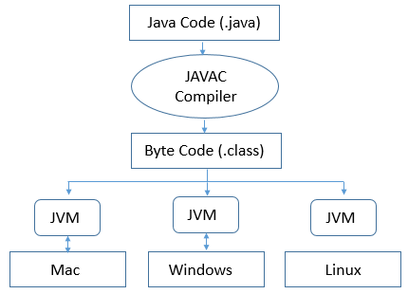
Write Once, Run Anywhere

Slide 7
Java Development Kit (JDK)
JDK contains tools required to write Java programs, and JRE to execute them.
It includes a compiler, Java application launcher, Applet viewer, etc.
Compiler converts code written in Java into byte code.
Java application launcher opens a JRE, loads the necessary class, and executes its main method.
https://bit.ly/2RiZT3H

Slide 8
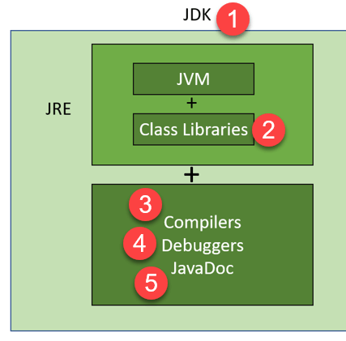
How JDK Functions?

Slide 9
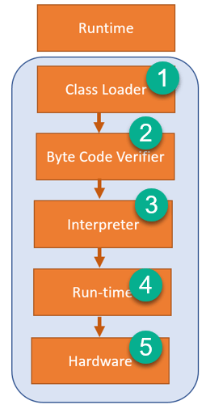
How JRE Functions?

Slide 10
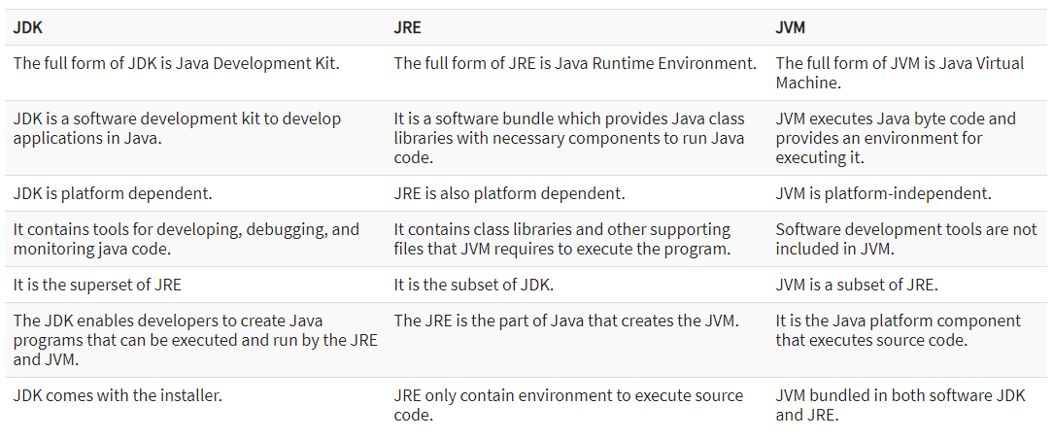
JDK vs. JRE vs. JVM

Slide 11
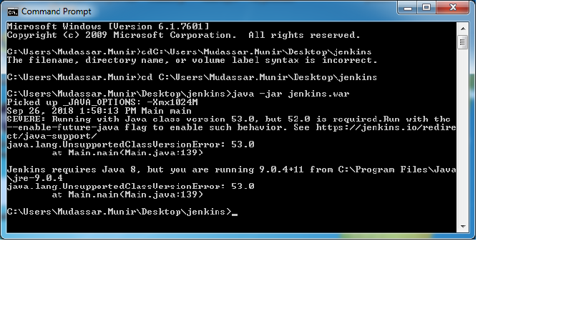
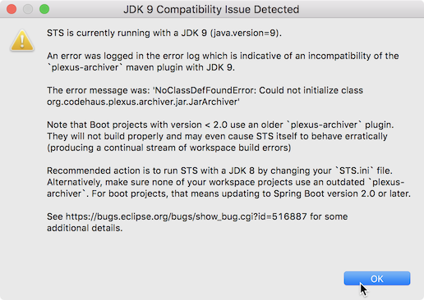
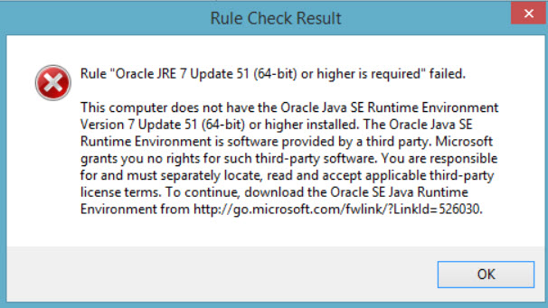
Different kind of compilation issues

Slide 12
Other Virtual Machines (VMs)
Common Language Runtime (CLR): It is a runtime environment provides by Microsoft to run the C# programming language.
Top similarities between the CLR and JVM include:
Both Virtual Machines (VMs)
Both include garbage collection
Both employ stack-based operations
Both include runtime-level security
Both have methods for exception handling
https://bit.ly/35voBpK

Slide 13
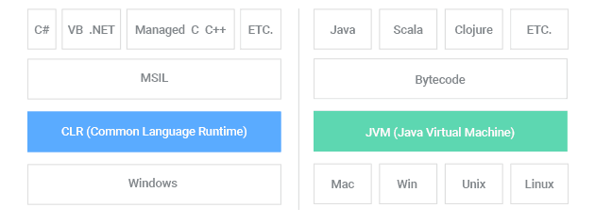
CLR vs JVM High-Level Functionality
https://bit.ly/35voBpK

Slide 14
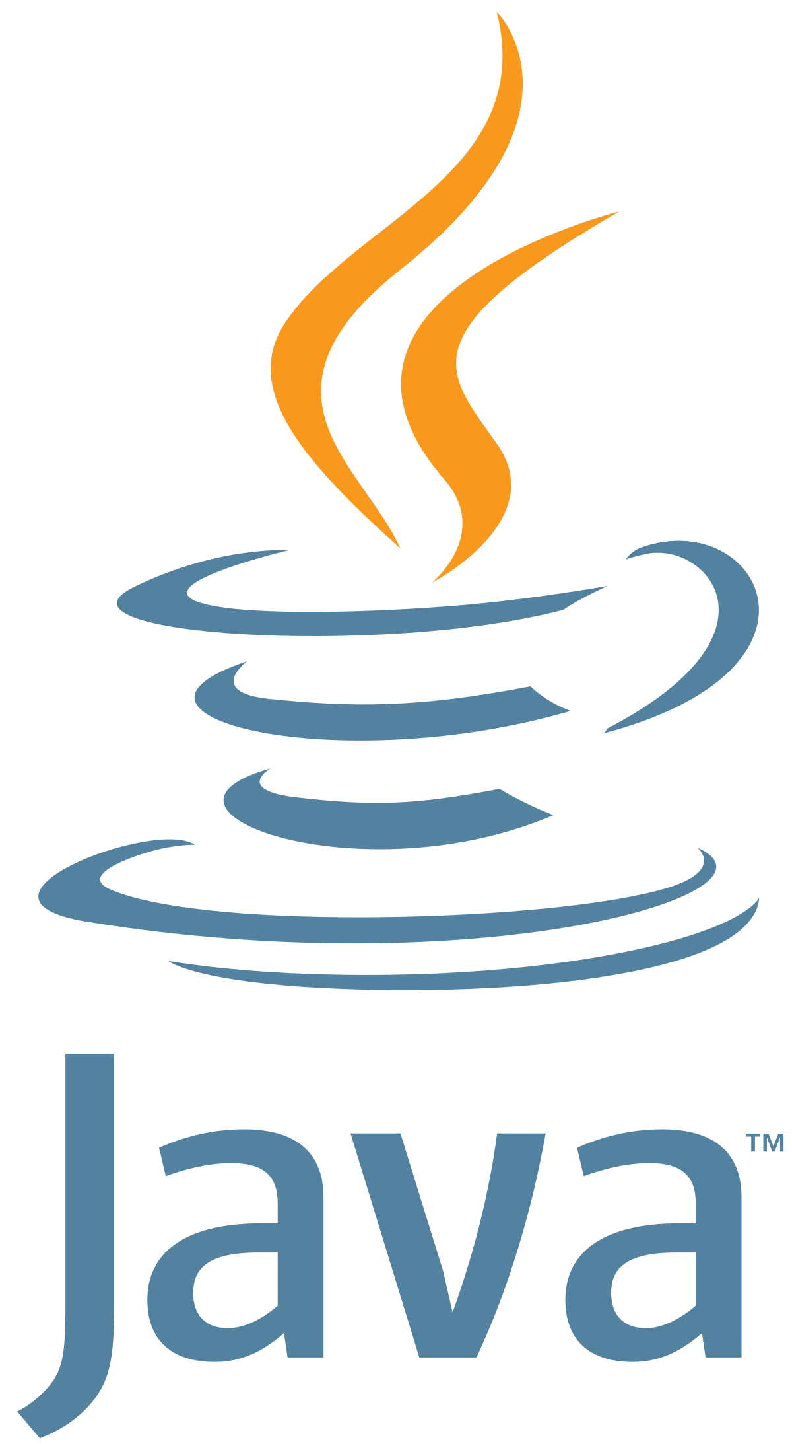
Installing Java Development Kit

Slide 15
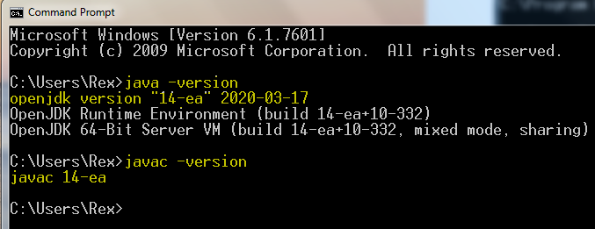
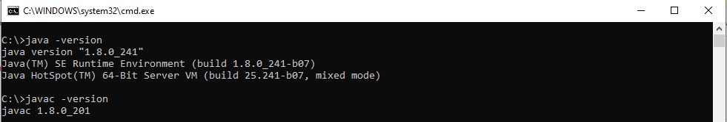
Steps to install JDK
Download latest Java SE 8 JDK (not JRE) from: https://bit.ly/2DX6qhw
For student like to try OpenJDK from : https://jdk.java.net/14/
After installation is complete, type javac –version in the Command.

Slide 16


Steps to install IDE
Eclipse is the most widely used IDE.
Follow the steps in the link: https://www.eclipse.org/downloads/packages/installer
Alternative: IntelliJ IDEA (JetBrains)
Follow the steps in the link:
https://www.jetbrains.com/help/idea/installation-guide.html

Slide 17
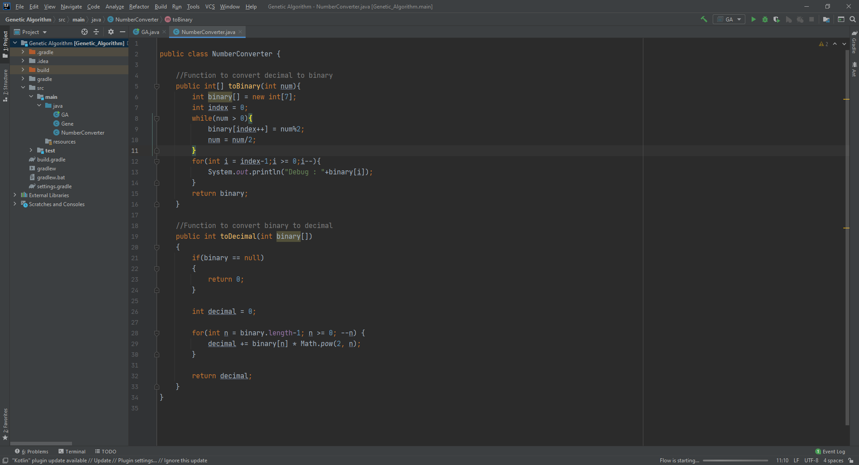
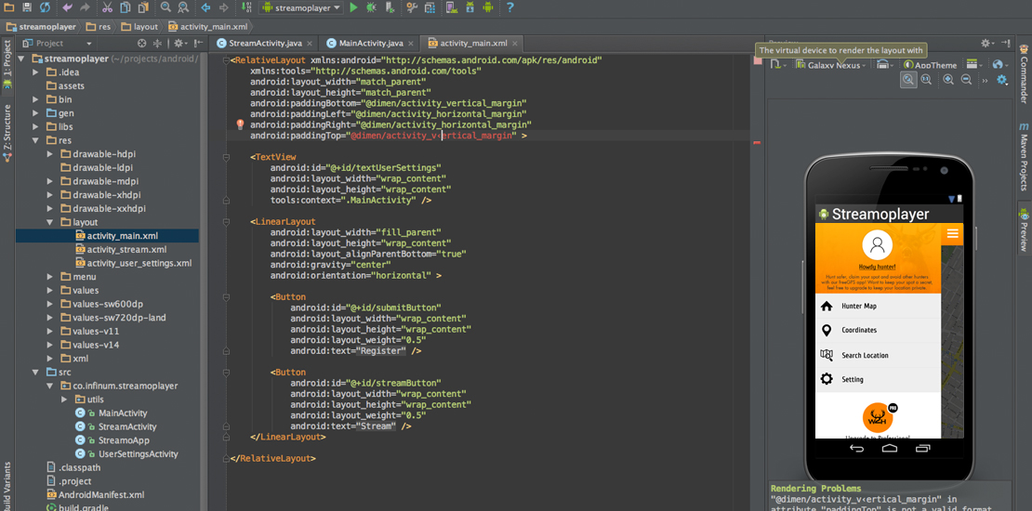

Why IntelliJ IDEA?
Intellij
Android studio
For more information about Android studio see: https://developer.android.com/studio/intro

Slide 18
Java programming language

Slide 19
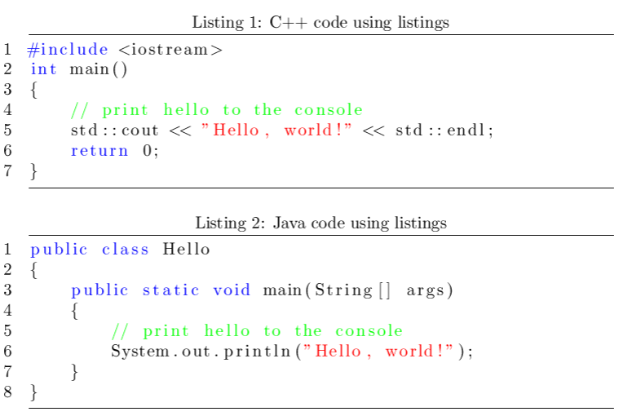
Code syntax

Slide 20
Language Features

Slide 21
Built-in Data Types

Slide 22
String Data Type

Slide 23
Java Math Library

Slide 24
Exercises: Command Line Arguments
Create the Java program that takes a name as command-line argument and prints “Hi <name>, Welcome in course COEN 352!”.
Create a Java class named IntOpsin that performs integer operations on a pair of integers from the command line and prints the results.

